Slide 1
Team Code Blooded
Problem Statement : Method Trace Analyzer

Slide 2



Team
Sathyajith KS Developer
Mathana Kumar S Developer
Geethesh TG Design & Testing
Developer
Developer
Design and Testing
Sathyajith KS
Mathana Kumar S
Geethesh T G

Slide 3

Overview
A neat GUI to generate trace files, compare them and create a csv file and a report of where the test cases fail, which makes debugging much more easier.

Slide 4
Problems to solve
Generating a Xtrace file every time
Parsing only the necessary information
1
3
2
Converting into an understandable format
4
Finally, Comparing those Xtrace files and debugging using it.

Slide 5
Technologies Used
IBM Xtrace Option Builder
1
Python CSV module
2
Java
3
Tkinter for GUI
4

Slide 6
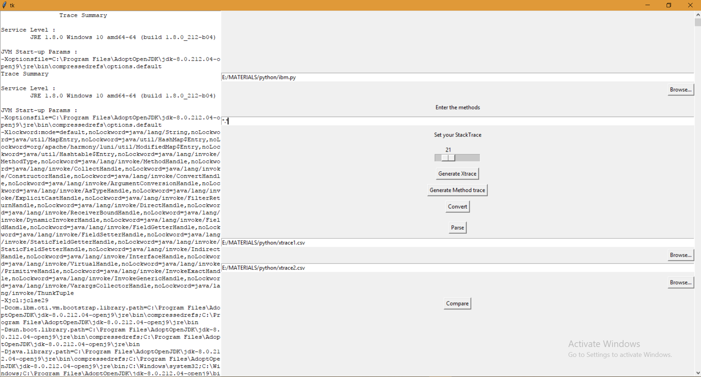
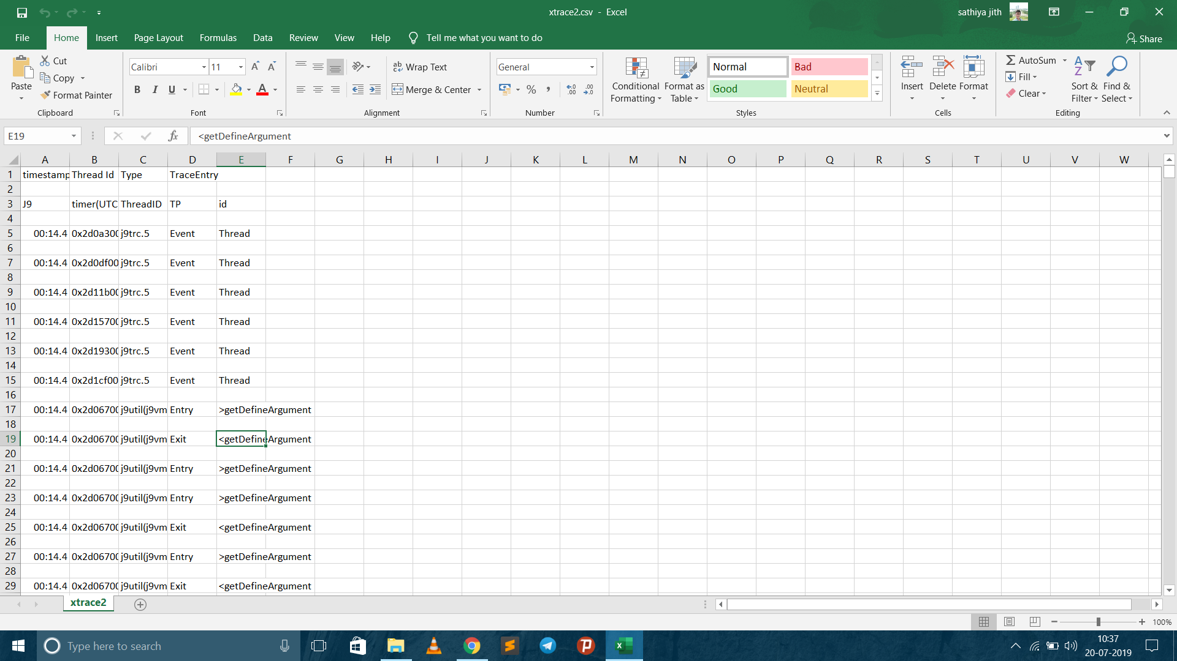
Some Instances of our tool

Slide 7




Architecture Diagram:
Simplified Trace output in CSV format
Tkinter GUI
IBM
Xtrace
Command
Python
Code

Slide 8
Logic Diagram
Open the java file using browse button
Enter the methods and adjust the stack depth
Generate trace files by clicking Generate Xtrace
Click Convert to convert it into human readable form
Click compare to compare them
Then browse 2 csv files to compare them
Click Parse to create a csv file

Slide 9
Framework Used Tkinter
Tkinter has many supportive widgets like:
Text Widget
Entry Widget
Label Widget
Button widget
Also it has simple callback methods for each of it’s widgets.
All of it’s widgets can be given varied functionality and customized to the fullest.

Slide 10
Thank you.

